Slide 1
Improvement of Load Cell Frame
AUTOMATIC COMPACTOR

Slide 2
METHODOLOGY
Install temporary support member below the beam that will be aligned
Perform cutting on both ends of the beam joint.
Align beam and perform initial welding. This will be the first checking of the beam level with TBMC and Megantech.
Conduct first phase of welding. Do not full weld on one side. See details of weld sequence.
TBMC and Megantech will conduct the 2nd beam alignment verification. If beam is still not horizontally aligned, redo the process.

Slide 3
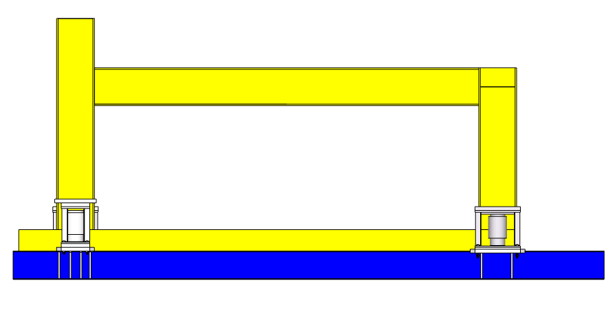
REPLACEMENT METHOD:
1. Install temporary support member below the beam that will be aligned
Beam to be aligned
Temporary Support

Slide 4
REPLACEMENT METHOD:
2. Perform cutting on both ends of the beam joint.
Joint to cut
Temporary Support

Slide 5
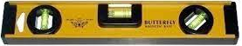
REPLACEMENT METHOD:
3. Align beam and perform initial welding. This will be the first checking of the beam level with TBMC and Megantech.
Use level bar to verify beam alignment, if OK, proceed with the welding
Temporary Support

Slide 6
REPLACEMENT METHOD:
4. Conduct first phase of welding. Do not full weld on one side. See details of weld sequence.
1st
3rd
8th
5th
6th
7th
5th
8th
7th
6th
4th
2nd
Temporary Support

Slide 7
REPLACEMENT METHOD:
5. TBMC and Megantech will conduct the 2nd beam alignment verification. If beam is still not horizontally aligned, redo the process.
Use level bar to verify beam alignment, if OK, proceed with the finishing activities
Temporary Support

Slide 8
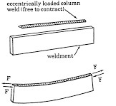
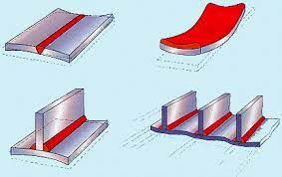
WARPING SAMPLE IMAGES
WARPING

Slide 9
REPLACEMENT METHOD:
4. Conduct first phase of welding. Do not full weld on one side. See details of weld sequence.
Temporary Support

Slide 10
END

